Slide 1
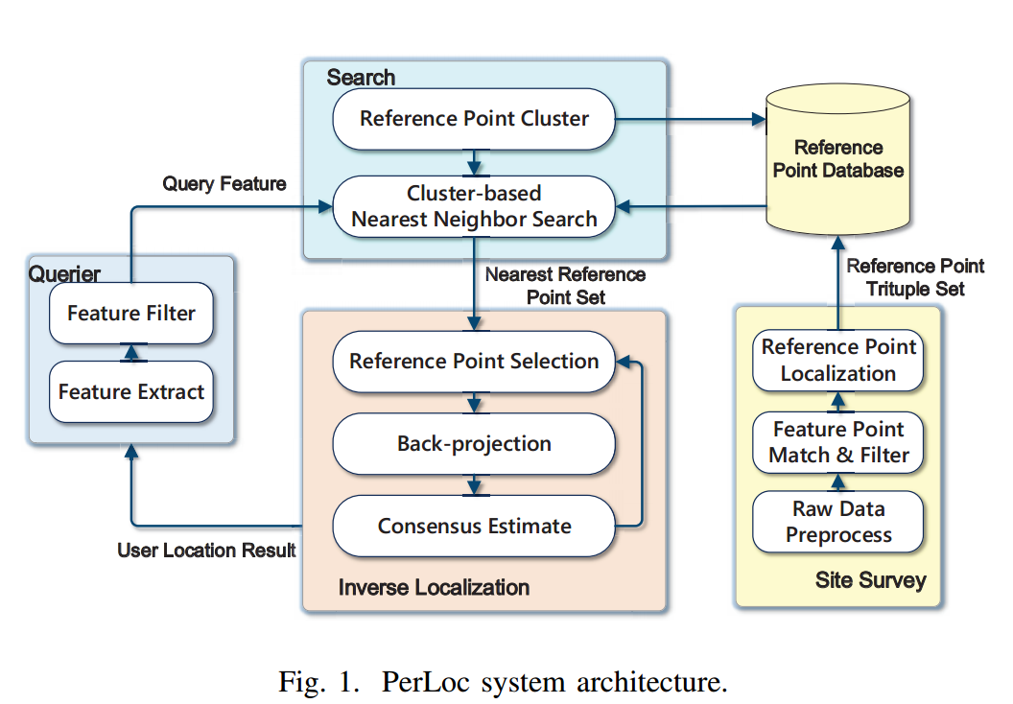
System architecture
Perloc includes 4 components:
querier, site survey component,
search scheme and inverse localization.

Slide 2
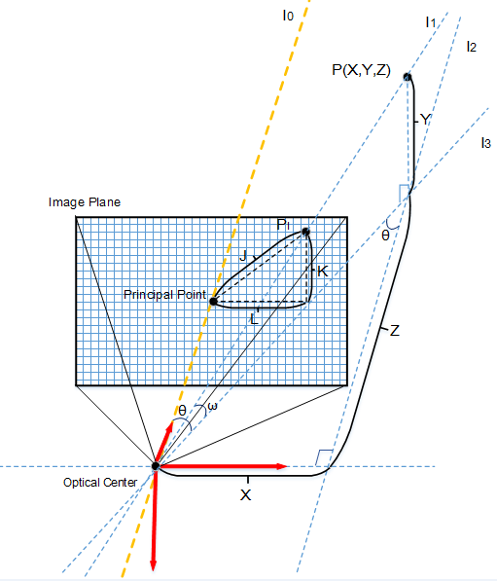
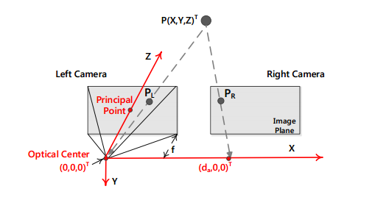







Reference point geographical coordinates calculation
Calculate reference point’s depth
based on binocular ranging technique.
Estimate reference point geographical coordinates
according to depth.

Slide 3
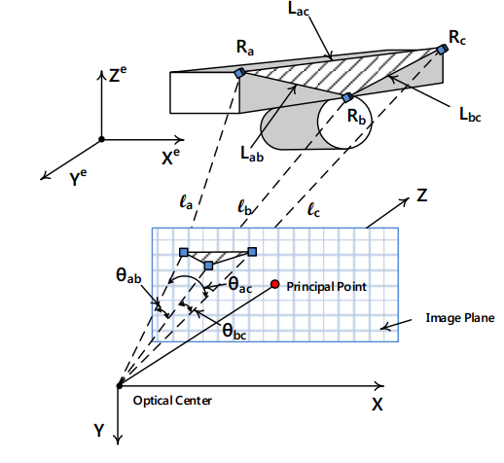


Inverse localization
Determine user’s location by solving equation groups and leveraging RANSAC method to estimate error of each solution.

Slide 4
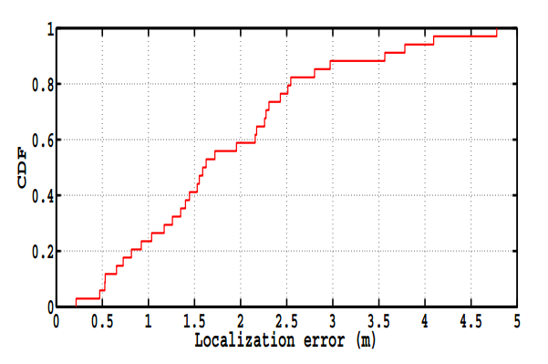
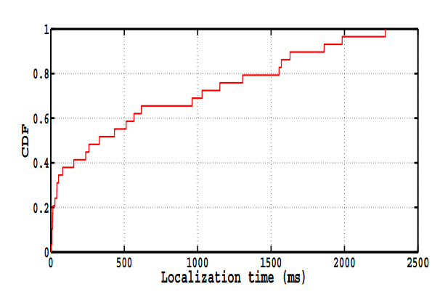
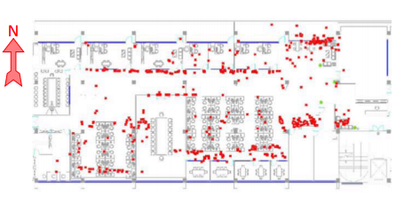
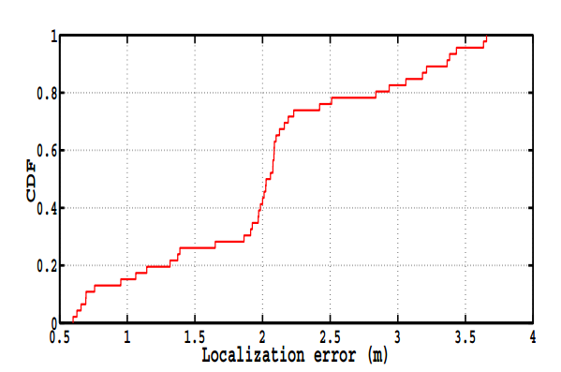
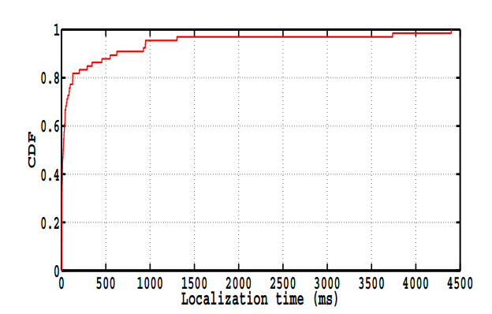
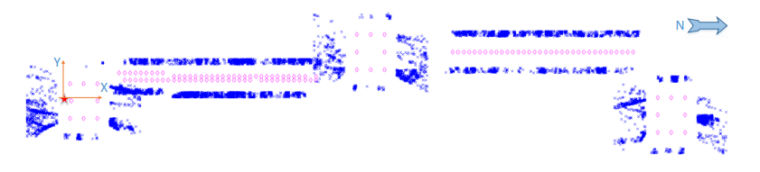
System Evaluation
Office
Office floor plan.
CDF of localization error.
CDF of localization time.
Shopping
mall
Shopping mall floor plan
CDF of localization error.
CDF of localization time.

